Slide 1
Resiliens og Samtidighed

Slide 2
Agenda
Resilience på back-end systemer
Eksempel - Polly C#
Concurrency i EF Core
Disconnected Concurrent Update Issue

Slide 3
Resilience på back-end
Microservices
transient errors
Strategier til at håndtere
Retry - Polly
Circuit breaker - Polly
Bulkhead
Fallbacks
Proactive vs reactive

Slide 4
Polly eksempel

Slide 5
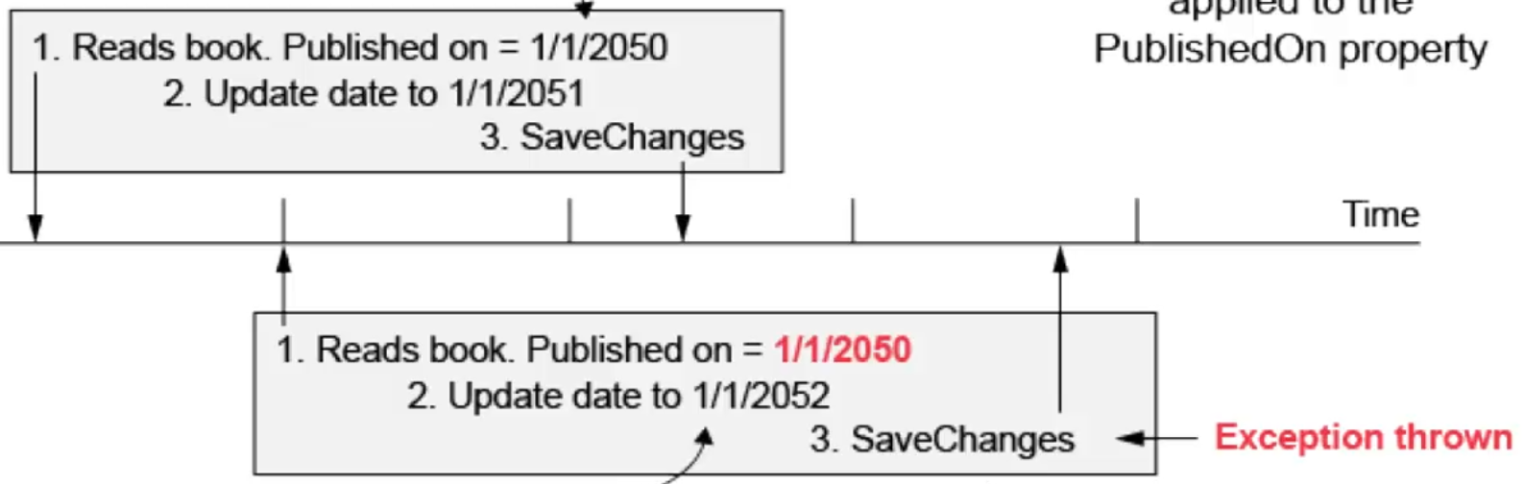
Concurrency i EF Core
Pessimistic concurrency
Slow, locking, unsupported by EF Core
Optimistic concurrency
Last write wins
EF Core standard
Concurrency Token
Timestamp
ConcurrencyException
Solving concurrency by design
Event Sourcing

Slide 6
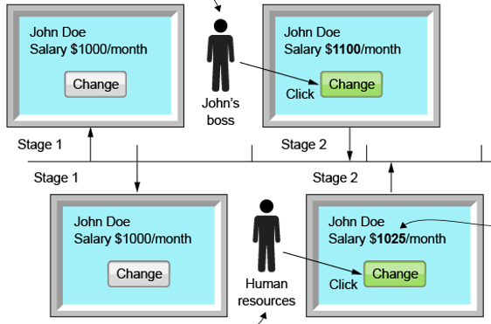
Disconnected Concurrent update issue
2 Stage phase
Min vs ms
Fix
ConcurrencyCheck
.OriginalValue
Prompt user
Considerations
Store last editor

